Slide 1
UNIONS

Slide 2
DEFINITION
A union is a user-defined type similar to structs in C except for one key difference.
Structs allocate enough space to store all its members whereas unions allocate the space to store only the largest member.

Slide 3
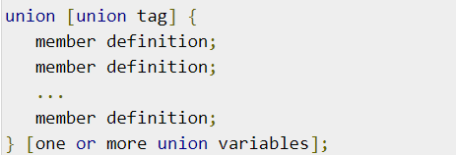
DEFINING A UNION
To define a union, you must use the union statement in the same way as you did while defining a structure. The union statement defines a new data type with more than one member for your program. The format of the union statement is as follows −

Slide 4
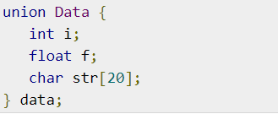
The union tag is optional and each member definition is a normal variable definition, such as int i; or float f; or any other valid variable definition. At the end of the union's definition, before the final semicolon, you can specify one or more union variables but it is optional

Slide 5
ACCESSING UNION MEMBERS
To access any member of a union, we use the member access operator (.). The member access operator is coded as a period between the union variable name and the union member that we wish to access

Slide 6
THANK YOU

